Slide 1

Logistic Regression Part 3
Dr Mehrdad Ghaziasgar
Senior Lecturer in Computer Science
Department of Computer Science
University of the Western Cape
mghaziasgar@uwc.ac.za

Slide 2
Content
Part 1:
Classification With Logistic Regression
Model Evaluation For Classification
Part 2:
Overfitting and Underfitting
Part 3:
Practical Issues With Classification

Slide 3
Content – Part 3
Practical Issues
Introduction
Polynomial Degree?
How Much to Regularize?
Training Set Size?

Slide 4
Practical Issues
Introduction
Overfitting and Underfitting
Introduction
Polynomial Degree?
How Much to Regularize?
Training Set Size?

Slide 5








Introduction
In the previous part we discovered that the degree of polynomial that we use can affect accuracy:
Too low: the model will have high bias: too simple
Too high: the model will have high variance: too complex and “hugging” the data
3
3
Practical Issues
$$y$$
$$y$$
2
2
1
1
train
1
2
3
$$x$$
test
1
2
3
$$x$$
$$h_{θ}\left(x\right)=θ_{0}+{ θ}_{1}x$$
$$h_{θ}\left(x\right)=θ_{0}+{ θ}_{1}x+{ θ}_{2}x^{2}+{ θ}_{3}x^{3}$$
$+{ θ}_{4}x^{4}$
degree $d$ = 1
degree $d$ = 4

Slide 6
Introduction
In the previous part we discovered that the degree of polynomial that we use can affect accuracy:
Too low: the model will have high bias: too simple
Too high: the model will have high variance: too complex and “hugging” the data
We looked at bias and variance:
Bias: the model is too simple
The model doesn’t fit either the train or test data well
Variance: the model is too complex
The model fits the train data VERY well but doesn’t fit the test data well
In both cases: the model fails to predict the test data well (which is what we’re interested in in the first place)
Practical Issues

Slide 7
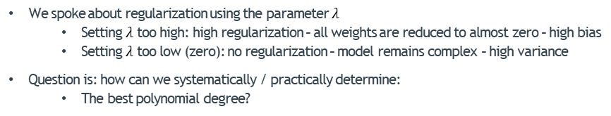
Introduction
We spoke about regularization using the parameter $λ$
Setting $λ$ too high: high regularization – all weights are reduced to almost zero – high bias
Setting $λ$ too low (zero): no regularization – model remains complex – high variance
Question is: how can we systematically / practically determine:
The best polynomial degree?
Practical Issues

Slide 8








Introduction
We spoke about regularization using the parameter $λ$
Setting $λ$ too high: high regularization – all weights are reduced to almost zero – high bias
Setting $λ$ too low (zero): no regularization – model remains complex – high variance
Question is: how can we systematically / practically determine:
The best polynomial degree?
Practical Issues
3
3
3
$$y$$
2
$$y$$
2
$$y$$
2
1
1
1
train
1
2
3
1
2
3
test
1
2
3
$$x$$
$$x$$
$$x$$
$$h_{θ}\left(x\right)=θ_{0}+{ θ}_{1}x$$
$$h_{θ}\left(x\right)=θ_{0}+{ θ}_{1}x+{ θ}_{2}x^{2}$$
$$h_{θ}\left(x\right)=θ_{0}+{ θ}_{1}x+{ θ}_{2}x^{2}+{ θ}_{3}x^{3}$$
$+{ θ}_{4}x^{4}$
degree $d$ = 1
degree $d$ = 2 (“just right”)
degree $d$ = 4

Slide 9
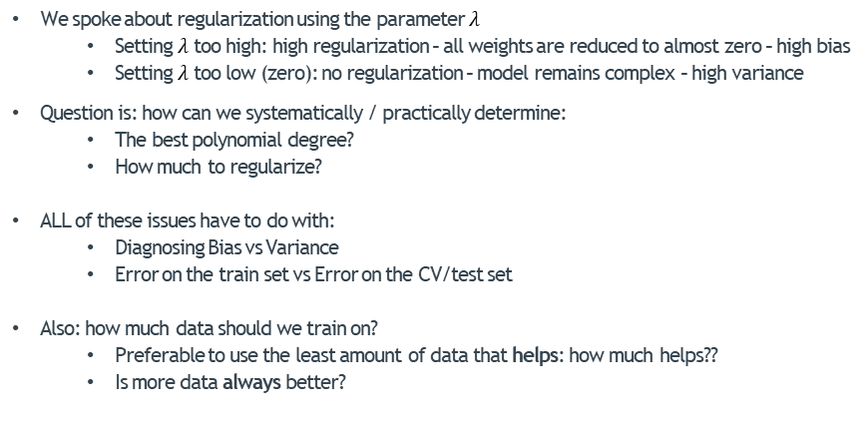
Introduction
We spoke about regularization using the parameter $λ$
Setting $λ$ too high: high regularization – all weights are reduced to almost zero – high bias
Setting $λ$ too low (zero): no regularization – model remains complex – high variance
Question is: how can we systematically / practically determine:
The best polynomial degree?
How much to regularize?
ALL of these issues have to do with:
Diagnosing Bias vs Variance
Error on the train set vs Error on the CV/test set
Also: how much data should we train on?
Preferable to use the least amount of data that helps: how much helps??
Is more data always better?
Practical Issues

Slide 10
Practical Issues
Polynomial Degree?
Overfitting and Underfitting
Introduction
Polynomial Degree?
How Much to Regularize?
Training Set Size?

Slide 11
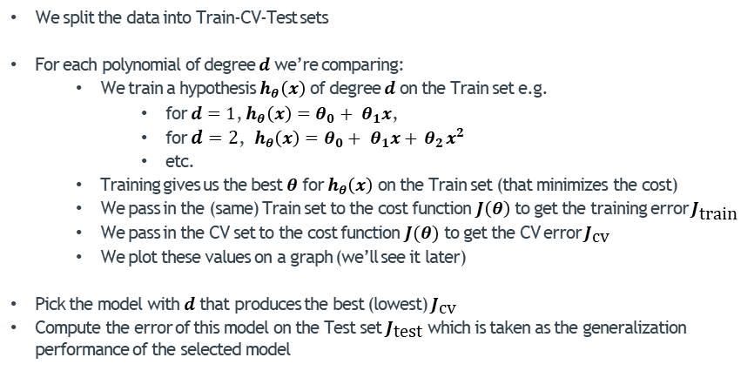
Determining Polynomial Degree
We split the data into Train-CV-Test sets
For each polynomial of degree $d$ we’re comparing:
We train a hypothesis $h_{θ}\left(x\right)$ of degree $d$ on the Train set e.g.
for $d=1$, $h_{θ}\left(x\right)=θ_{0}+{ θ}_{1}x$,
for $d=2$, $h_{θ}\left(x\right)=θ_{0}+{ θ}_{1}x+{ θ}_{2}x^{2}$
etc.
Training gives us the best $θ$ for $h_{θ}\left(x\right)$ on the Train set (that minimizes the cost)
We pass in the (same) Train set to the cost function $J\left(θ\right)$ to get the training error $J_{\text{train}}$
We pass in the CV set to the cost function $J(θ)$ to get the CV error $J_{\text{cv}}$
We plot these values on a graph (we’ll see it later)
Pick the model with $d$that produces the best (lowest) $J_{\text{cv}}$
Compute the error of this model on the Test set $J_{\text{test}}$ which is taken as the generalization performance of the selected model
Practical Issues

Slide 12
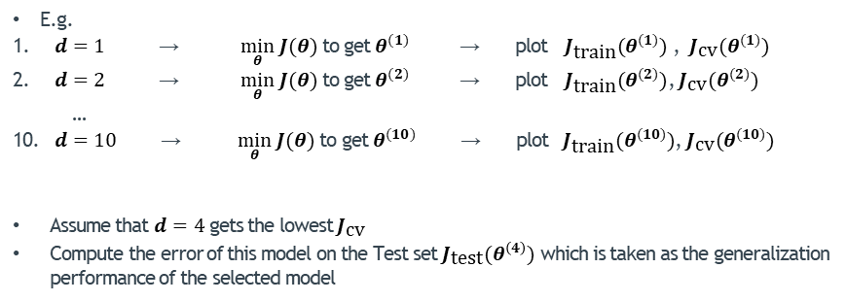
Determining Polynomial Degree
E.g.
$d=1$ → $\min_{θ} J(θ)$ to get $θ^{(1)}$ → plot $J_{\text{train}}(θ^{(1)})$ , $J_{\text{cv}}(θ^{(1)})$
$d=2$ → $\min_{θ} J(θ)$ to get $θ^{(2)}$ → plot $J_{\text{train}}(θ^{(2)})$, $J_{\text{cv}}(θ^{(2)})$
…
$d=10$ → $\min_{θ} J(θ)$ to get $θ^{(10)}$ → plot $J_{\text{train}}(θ^{(10)})$, $J_{\text{cv}}(θ^{(10)})$
Assume that $d=4$ gets the lowest $J_{\text{cv}}$
Compute the error of this model on the Test set $J_{\text{test}}(θ^{\left(4\right)})$ which is taken as the generalization performance of the selected model
Practical Issues

Slide 13











Determining Polynomial Degree
The plot of the two errors $J_{\text{train}}$ and $J_{\text{cv}}$ versus the parameter we’re optimizing i.e. $d$:
$$J_{\text{cv}}$$
train
Error $J$
cv
Practical Issues
$$h_{θ}\left(x\right)=θ_{0}+{ θ}_{1}x+{ θ}_{2}x^{2}$$
$+{ θ}_{3}x^{3}+{ θ}_{4}x^{4}$
$$h_{θ}\left(x\right)=θ_{0}+{ θ}_{1}x$$
3
3
2
$$y$$
$$y$$
2
1
1
$$J_{\text{train}}$$
1
2
3
$$x$$
1
2
3
$$x$$
$$d$$
degree $d$ = 4
degree $d$ = 1
(“just right”)

Slide 14




Determining Polynomial Degree
Bias:
$J_{\text{train}}≈J_{\text{cv}}$ and both errors are large
Variance:
$J_{\text{train}}≈0$ and $J_{\text{cv}}$ is large so
$J_{\text{cv}}≫J_{\text{train}}$
$$J_{\text{train}}≈J_{\text{cv}}$$
(both large)
$$J_{\text{cv}}$$
train
Error $J$
cv
Practical Issues
$$J_{\text{train}}≈0$$
$J_{\text{cv}}$ is large
$$J_{\text{cv}}≫J_{\text{train}}$$
$$h_{θ}\left(x\right)=θ_{0}+{ θ}_{1}x+{ θ}_{2}x^{2}$$
$+{ θ}_{3}x^{3}+{ θ}_{4}x^{4}$
$$h_{θ}\left(x\right)=θ_{0}+{ θ}_{1}x$$
3
3
2
$$y$$
$$y$$
2
1
1
$$J_{\text{train}}$$
1
2
3
$$x$$
1
2
3
$$x$$
$$d$$
degree d = 4
degree d = 1
(bias)
(“just right”)
(variance)

Slide 15
Practical Issues
How Much to Regularize?
Overfitting and Underfitting
Introduction
Polynomial Degree?
How Much to Regularize?
Training Set Size?

Slide 16
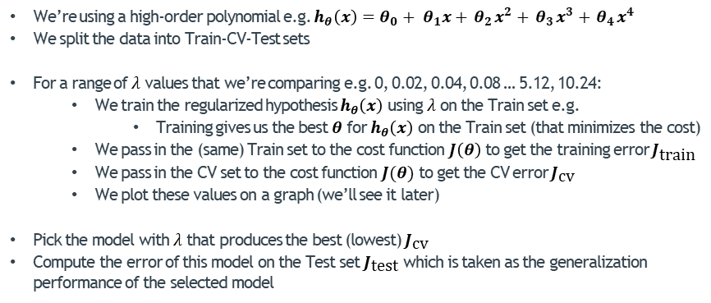
Determining How Much to Regularize
We’re using a high-order polynomial e.g. $h_{θ}\left(x\right)=θ_{0}+{ θ}_{1}x+{ θ}_{2}x^{2}+{ θ}_{3}x^{3}+{ θ}_{4}x^{4}$
We split the data into Train-CV-Test sets
For a range of $λ$ values that we’re comparing e.g. 0, 0.02, 0.04, 0.08 … 5.12, 10.24:
We train the regularized hypothesis $h_{θ}\left(x\right)$ using $λ$ on the Train set e.g.
Training gives us the best $θ$ for $h_{θ}\left(x\right)$ on the Train set (that minimizes the cost)
We pass in the (same) Train set to the cost function $J\left(θ\right)$ to get the training error $J_{\text{train}}$
We pass in the CV set to the cost function $J(θ)$ to get the CV error $J_{\text{cv}}$
We plot these values on a graph (we’ll see it later)
Pick the model with $λ$ that produces the best (lowest) $J_{\text{cv}}$
Compute the error of this model on the Test set $J_{\text{test}}$ which is taken as the generalization performance of the selected model
Practical Issues

Slide 17
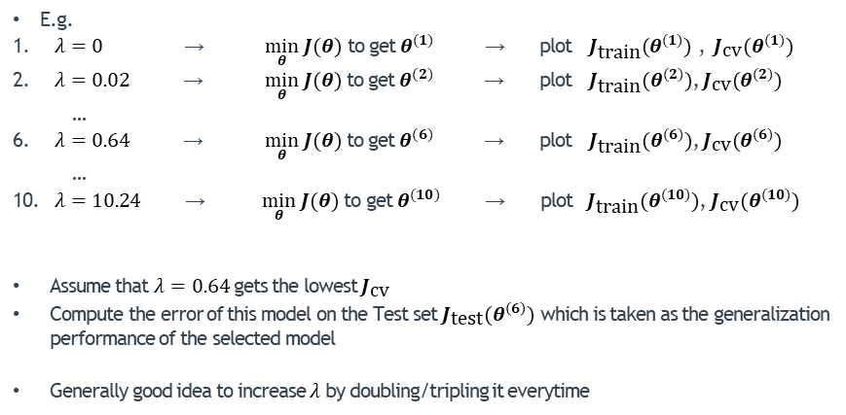
Determining How Much to Regularize
E.g.
$λ=0$ → $\min_{θ} J(θ)$ to get $θ^{(1)}$ → plot $J_{\text{train}}(θ^{(1)})$ , $J_{\text{cv}}(θ^{(1)})$
$λ=0.02$ → $\min_{θ} J(θ)$ to get $θ^{(2)}$ → plot $J_{\text{train}}(θ^{(2)})$, $J_{\text{cv}}(θ^{(2)})$
…
$λ=0.64$ → $\min_{θ} J(θ)$ to get $θ^{(6)}$ → plot $J_{\text{train}}(θ^{(6)})$, $J_{\text{cv}}(θ^{(6)})$
…
$λ=10.24$ → $\min_{θ} J(θ)$ to get $θ^{(10)}$ → plot $J_{\text{train}}(θ^{(10)})$, $J_{\text{cv}}(θ^{(10)})$
Assume that $λ=0.64$ gets the lowest $J_{\text{cv}}$
Compute the error of this model on the Test set $J_{\text{test}}(θ^{\left(6\right)})$ which is taken as the generalization performance of the selected model
Generally good idea to increase $λ$by doubling/tripling it everytime
Practical Issues

Slide 18











Determining How Much to Regularize
The plot of the two errors $J_{\text{train}}$ and $J_{\text{cv}}$ versus the parameter we’re optimizing i.e.$λ$:
train
cv
Error $J$
$$J_{\text{cv}}$$
$$h_{θ}\left(x\right)=θ_{0}+{ θ}_{1}x+{ θ}_{2}x^{2}$$
$+{ θ}_{3}x^{3}+{ θ}_{4}x^{4}$
Practical Issues
$$h_{θ}\left(x\right)=θ_{0}+{ θ}_{1}x+{ θ}_{2}x^{2}$$
$+{ θ}_{3}x^{3}+{ θ}_{4}x^{4}$
3
3
$$y$$
2
2
$$y$$
1
1
1
2
3
$$x$$
1
2
3
$$J_{\text{train}}$$
$$x$$
$$λ=0$$
$λ=1000$ (very large)
No regularization
$$θ_{1}≈θ_{2}≈θ_{3}≈θ_{4}≈0$$
$$λ$$
(“just right”)
So $h_{θ}\left(x\right)≈θ_{0}$

Slide 19



Determining How Much to Regularize
Bias:
$J_{\text{train}}≈J_{\text{cv}}$ and both errors are large
Variance:
$J_{\text{train}}≈0$ and $J_{\text{cv}}$ is large so
$J_{\text{cv}}≫J_{\text{train}}$
train
cv
$$J_{\text{train}}≈J_{\text{cv}}$$
(both large)
Error $J$
$$J_{\text{cv}}$$
$$h_{θ}\left(x\right)=θ_{0}+{ θ}_{1}x+{ θ}_{2}x^{2}$$
$+{ θ}_{3}x^{3}+{ θ}_{4}x^{4}$
Practical Issues
$$h_{θ}\left(x\right)=θ_{0}+{ θ}_{1}x+{ θ}_{2}x^{2}$$
$+{ θ}_{3}x^{3}+{ θ}_{4}x^{4}$
3
3
$$J_{\text{train}}≈0$$
$J_{\text{cv}}$ is large
$$J_{\text{cv}}≫J_{\text{train}}$$
$$y$$
2
2
$$y$$
1
1
1
2
3
$$x$$
1
2
3
$$J_{\text{train}}$$
$$x$$
$$λ=0$$
$λ=1000$ (very large)
No regularization
$$θ_{1}≈θ_{2}≈θ_{3}≈θ_{4}≈0$$
$$λ$$
(variance)
(“just right”)
(bias)
So $h_{θ}\left(x\right)≈θ_{0}$

Slide 20
Practical Issues
Training Set Size?
Overfitting and Underfitting
Introduction
Polynomial Degree?
How Much to Regularize?
Training Set Size?

Slide 21
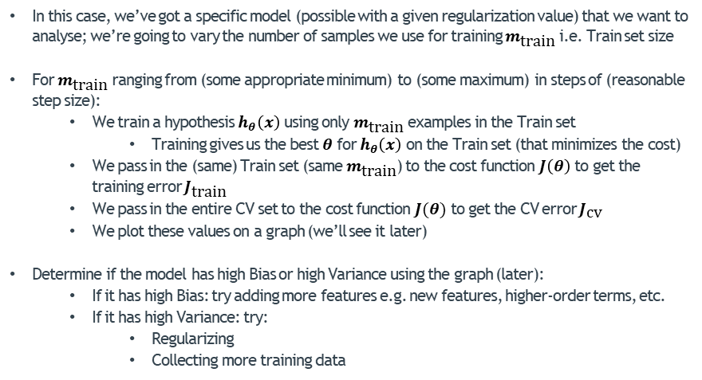
Determining How Much Training Data To Use
In this case, we’ve got a specific model (possible with a given regularization value) that we want to analyse; we’re going to vary the number of samples we use for training $m_{\text{train}}$ i.e. Train set size
For $m_{\text{train}}$ ranging from (some appropriate minimum) to (some maximum) in steps of (reasonable step size):
We train a hypothesis $h_{θ}\left(x\right)$ using only $m_{\text{train}}$ examples in the Train set
Training gives us the best $θ$ for $h_{θ}\left(x\right)$ on the Train set (that minimizes the cost)
We pass in the (same) Train set (same $m_{\text{train}}$) to the cost function $J\left(θ\right)$ to get the training error $J_{\text{train}}$
We pass in the entire CV set to the cost function $J(θ)$ to get the CV error $J_{\text{cv}}$
We plot these values on a graph (we’ll see it later)
Determine if the model has high Bias or high Variance using the graph (later):
If it has high Bias: try adding more features e.g. new features, higher-order terms, etc.
If it has high Variance: try:
Regularizing
Collecting more training data
Practical Issues

Slide 22













Determining How Much Training Data To Use
The plot of the two errors $J_{\text{train}}$ and $J_{\text{cv}}$ versus the parameter we’re optimizing i.e. $m_{\text{train}}$:
3
3
$$h_{θ}\left(x\right)=θ_{0}+{ θ}_{1}x+{ θ}_{2}x^{2}$$
2
2
$$y$$
$$y$$
1
$m_{\text{train}}$= 1
1
$m_{\text{train}}$= 2
Error $J$
1
2
3
$$x$$
1
2
3
$$x$$
Practical Issues
$$J_{\text{cv}}$$
3
3
2
2
$$y$$
$$y$$
1
$m_{\text{train}}$= 3
1
$m_{\text{train}}$= 4
1
2
3
$$x$$
1
2
3
$$x$$
$$J_{\text{train}}$$
3
3
2
2
$$y$$
$$y$$
1
$m_{\text{train}}$= 5
1
$m_{\text{train}}$= 6
train
$$m_{\text{train}}$$
1
2
3
$$x$$
1
2
3
$$x$$
cv

Slide 23
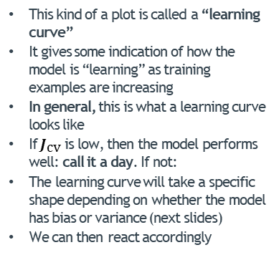
Determining How Much Training Data To Use
The plot of the two errors $J_{\text{train}}$ and $J_{\text{cv}}$ versus the parameter we’re optimizing i.e. $m_{\text{train}}$:
This kind of a plot is called a “learning curve”
It gives some indication of how the model is “learning” as training examples are increasing
In general, this is what a learning curve looks like
If $J_{\text{cv}}$ is low, then the model performs well: call it a day. If not:
The learning curve will take a specific shape depending on whether the model has bias or variance (next slides)
We can then react accordingly
Error $J$
Practical Issues
$$J_{\text{cv}}$$
$$J_{\text{train}}$$
$$m_{\text{train}}$$

Slide 24

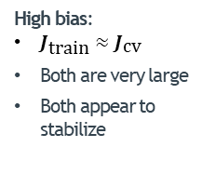


Determining How Much Training Data To Use – High Bias
If the model suffers from high bias, what will the learning curve will look like?
E.g. Imagine using a straight line $h_{θ}\left(x\right)=θ_{0}+{ θ}_{1}x$ to fit non-linear data as below
High bias:
$J_{\text{train}}≈J_{\text{cv}}$
Both are very large
Both appear to stabilize
Error $J$
$$J_{\text{cv}}$$
Practical Issues
3
$$J_{\text{train}}$$
3
2
$$y$$
$$y$$
2
1
1
1
2
3
$$x$$
1
2
3
$$m_{\text{train}}$$
$$x$$
train
$m_{\text{train}}$= 6
$m_{\text{train}}$= 17
cv

Slide 25
Determining How Much Training Data To Use – High Bias
If the model suffers from high bias, what will the learning curve will look like?
E.g. Imagine using a straight line $h_{θ}\left(x\right)=θ_{0}+{ θ}_{1}x$ to fit non-linear data as below
A high bias model is about the worst you can have
In this case: no amount of data will help
Don’t waste time/money collecting more data
The model is just too simple
Only one solution: back to the drawing board to make the model more complex
Add new features
Add higher-order features
Add combinations of features
Error $J$
$$J_{\text{cv}}$$
Practical Issues
$$J_{\text{train}}$$
$$m_{\text{train}}$$

Slide 26

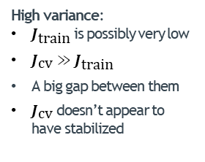



Determining How Much Training Data To Use – High Variance
If the model suffers from high variance, what will the learning curve will look like?
E.g. Imagine using an extremely high-order polynomial $h_{θ}\left(x\right)=θ_{0}+{ θ}_{1}x+{ θ}_{2}x^{2}+…+{ θ}_{50}x^{50}$ to fit data as below!
High variance:
$J_{\text{train}}$ is possibly very low
$J_{\text{cv}}≫$ $J_{\text{train}}$
A big gap between them
$J_{\text{cv}}$ doesn’t appear to have stabilized
Error $J$
$$J_{\text{cv}}$$
Practical Issues
big gap
3
3
2
$$J_{\text{train}}$$
$$y$$
$$y$$
2
1
1
1
2
3
$$x$$
$$m_{\text{train}}$$
1
2
3
train
$$x$$
$m_{\text{train}}$= 6
cv
$m_{\text{train}}$= 17

Slide 27

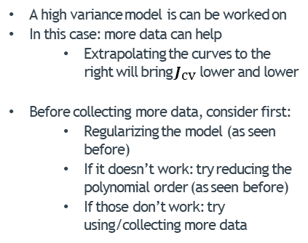
Determining How Much Training Data To Use – High Variance
If the model suffers from high variance, what will the learning curve will look like?
E.g. Imagine using an extremely high-order polynomial $h_{θ}\left(x\right)=θ_{0}+{ θ}_{1}x+{ θ}_{2}x^{2}+…+{ θ}_{50}x^{50}$ to fit data as below!
A high variance model is can be worked on
In this case: more data can help
Extrapolating the curves to the right will bring $J_{\text{cv}}$ lower and lower
Before collecting more data, consider first:
Regularizing the model (as seen before)
If it doesn’t work: try reducing the polynomial order (as seen before)
If those don’t work: try using/collecting more data
Error $J$
$$J_{\text{cv}}$$
Practical Issues
big gap
$$J_{\text{train}}$$
$$m_{\text{train}}$$

Slide 28
THE END
Of Logistic Regression

